Slide 1


Rosetta Stone
Subscriber Analysis
MGSC 410: Applied Business Analytics
November 30th, 2023
David Veksler, Willie Sine, Kyle Sharp, Kreesh Teli, Samith Lakka, Matthew Urata-Espinosa

Slide 2
Presentation Overview
Preliminary Steps
Most Valuable Subscribers
Subscriber Segmentation
Subscribers with Upselling Potential
Subscriber Churn
Additional Opportunities
Executive Summary

Slide 3






Action Plan
Preliminary Evaluation
Analysis with Initial Modeling
Data Cleaning and Merging
Additional Modeling
Initial Modeling
Conclusive Analysis

Slide 4
Cleaning Process
Key Steps
Pre-Cleaning Dimensions | 12-Month Target Price​
Rows | Columns
24 | 40,013
Currency | Exchange Rate to USD
GBP | 1.22285
PLN | 0.24706
EUR | 1.0723
BRL | 0.20375
KRW | 0.00077
MXN | 0.05692
UAH | 0.02765
RUB | 0.01105
CHF | 1.10693
CAD | 0.72474
CZK | 0.04434
RON | 0.21426
AUD | 0.6516
THB | 0.0282
JPY | 0.00659
INR | 0.01202
COP | 0.00025
BGN | 0.54737
ZAR | 0.05341
HUF | 0.00281
Currency Standardized by Exchange rates
Purchase Amounts Capped at $1,000
Subscription Duration Column Created
Post-Cleaning Dimensions
Rows | Columns
27 | 10,043
App Activity Data Summarized and Merged
Additional Cleaning

Slide 5




Modeling and Analysis Summary
Modeling Type
Targeted Objectives
Utility
Linear Regression
Subscriber Segmentation
Most Valuable Subscribers
Low
Logistic Regression
Subscriber Churn
Medium
K-Means Cluster
Subscriber Churn
Upselling Customer Potential
High
Random Forests
Most Valuable Subscribers
Subscriber Churn
High
Percentile-Based Segmentation
Subscriber Segmentation
Most Valuable Subscribers
High

Slide 6
Subscriber Segmentation
Identifying Most Important Variables
50th Percentile-Based Segmentation
Adjusted Purchase Amount
Segment | Subscription Duration | USD-Adjusted Purchase Amount
1 | Below | Below
2 | Below | Above
3 | Above | Below
4 | Above | Above
Rosetta Stone Aims to Maximize Returns
Data Available in Abundance After Cleaning
Subscription Duration
Longer Duration = Higher Purchase Amount
Inference Confirmed by Linear Regression
Overall R² | 0.64
Duration R² | 0.61
Duration Coefficient | 0.005

Slide 7




Subscriber Segmentation
Segment 1
Below-average returns
Below-average duration
High likelihood of cancellation Tendency for shorter engagement
Undesired Subscriber
Segment 2
Below-average returns
Above-average duration
Purchase lowest-tier options
Likely auto renew their subscription
Casual Subscriber
Segment 3
Above-average returns
Below-average duration
High likelihood of cancellation
Organization-based subscribers
Cash Flow Subscriber
Segment 4
Above-average returns
Above-average duration
Most Valuable Subscribers
Desired Subscriber

Slide 8
Most Valuable Subscribers
Segment 4 ~ Most Valuable Subscribers Tend To:
Enable Autorenewal Feature
Have Higher App Activity
Be Categorized as a
Lifetime Subscriber

Slide 9
Most Valuable Subscribers
Random Forest Regression Findings
Summary
Random Forest Regression
Confirmed Percentile-Based Approach Findings
Discovered Email Open % to be Valuable
Valuable Subscribers:
Opt in for autorenewal
Exhibit High ID Counts
Categorized as Lifetime Subscribers
Open the Emails they Receive

Slide 10





Subscribers with Upselling Potential
K-Means Clustering Algorithm
Email Open %
Auto Renew
Subscription
Duration
Purchase
Amount
Hyperparameter Tuning
Four Distinct Customer Clusters

Slide 11
Subscribers with Upselling Potential
Customer Segment | Email Open Percentage | Auto Renew | Subscription Duration (Days) | Purchase Amount
Cluster 0 'Loyal Subscribers' | 0.87 | 0.54 | 2,291 | $57.40
Cluster 1 'Free-Trial Forgetters' | 0.08 | 1.00 | 304.99 | $51.89
Cluster 2 'Lifetime Subscribers' | 0.19 | 0.0014 | 28,710 | $203.55
Cluster 3 'Noisy Subscribers' | 0.04 | 0.00 | 986 | $29.88
K-Means Clustering Capability | 12-Month Target Price​
Silhouette Score | 0.622
K-Means Model
Attractive Customer Segments
'Loyal Subscribers'
Most attractive customer segment
Market similar offerings
'Lifetime Subscribers'
Second most attractive customer segment
Look to market additional business opportunities

Slide 12
Indications of Subscriber Churn
Logistic Regression
Random Forest Classification
Predictors for Auto Renew
Email Subscribers
Open/ Send Count
Demo User
Push Notifications
Free Trial User
Subscription Duration
Predictors for Auto Renew
Subscription Duration
Purchase Amount
ID Count
Email Open %
Activity Count
Demo User
Free Trial User
Click Count
Accuracy Scores | 12-Month Target Price​
Precision | 0.86
Recall | 0.65
F1 Score | 0.74
Hyper Parameters | 12-Month Target Price​
Number of Trees | 500
Max Features | 5

Slide 13


Indications of Subscriber Churn
Logistic Regression Findings
Positive Coefficients
Email Subscriber
Push Notification
Open Count
Negative Coefficients
Subscription Duration
Send Count

Slide 14
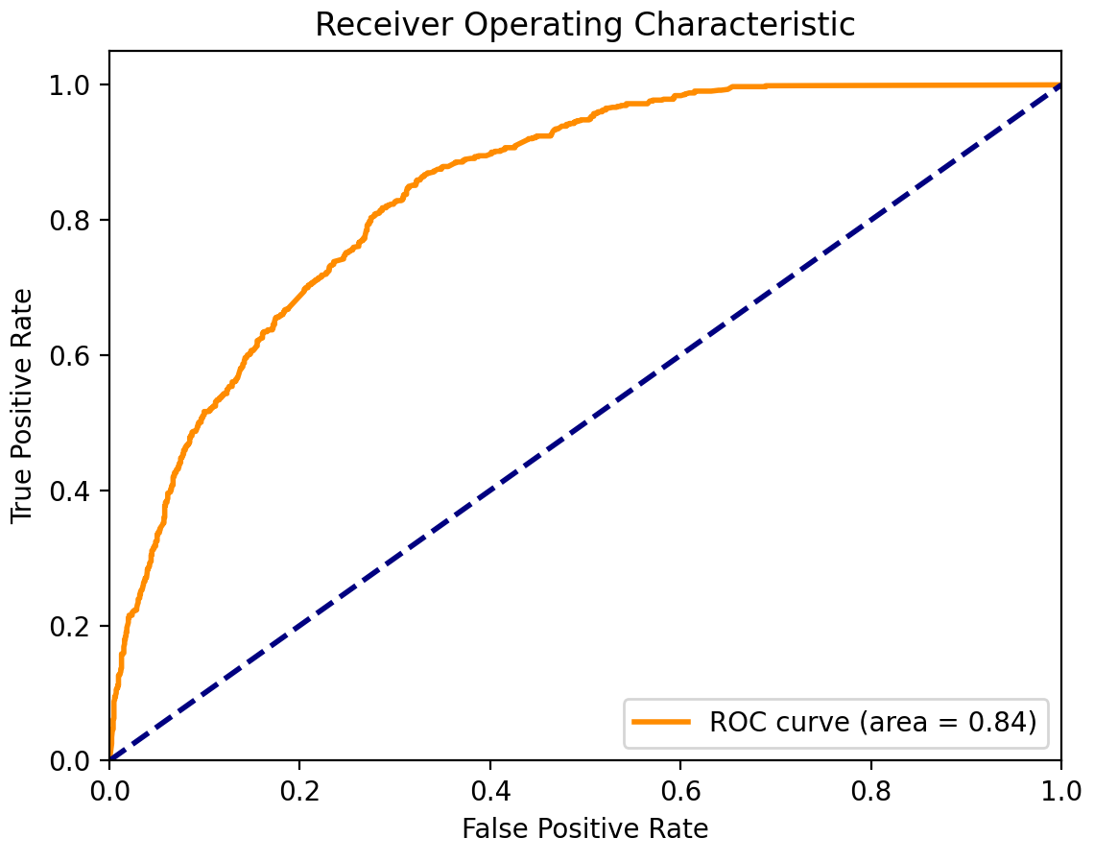
Indications of Subscriber Churn
Biggest indications of Customer Churn:
Subscription Duration, Purchase Amount,
ID Count, Email Open %
Gain ability to predict customer churn
with 84% accuracy

Slide 15


Additional Business Opportunities
Enhanced In-App Gamification
Leveraging User Engagement
Creating an Enjoyable Experience
Implement quests, badges, and challenges to captivate users, fostering high engagement
The incorporation of captivating features cultivates a dynamic and enjoyable atmosphere
Incentivize offerings for potential profit generation and increased customer engagement
Collating education with an engaging, immersive ‘game’ experience diversifies prospective subscriber engagement

Slide 16

Additional Business Opportunities
Community Centric Learning
Interactive Learning Exchanges
User Generated Content Hub
Real time sessions for users to converse with native or fellow learners
Centralized space for sharing tips, insights, and success stories
Increases retention within the platform and provides a reason to come back
Promotes community brand through content and ideas sharing

Slide 17
Executive Summary
Identifying Customer Segments
Four Customer Segments
Undesired Subscriber, Casual Subscriber,
Cash Flow Subscriber, & Desired Subscriber
Most Valuable Subscribers
Exhibited High Values
Subscription Duration, Purchase Amount, and Engagement with marketing efforts
Identifying Subscribers With Upselling Potential
K-Means Clustering Accentuated
‘Loyal Subscribers’ & ‘Lifetime Subscribers’
are Rosetta Stone’s most attractive segments for upsell
Indications of Subscriber Churn
Churning Customers
Subscribers with high subscription durations &
Receive spam emails
Additional Business Opportunities
Potential for Growth
Leveraging Subscriber Data, Incentivized Offerings, Creating Advanced and Personalized Offerings

Slide 18

Thank You

